Slide 1

Betrayal
At House on the Hill

Slide 2
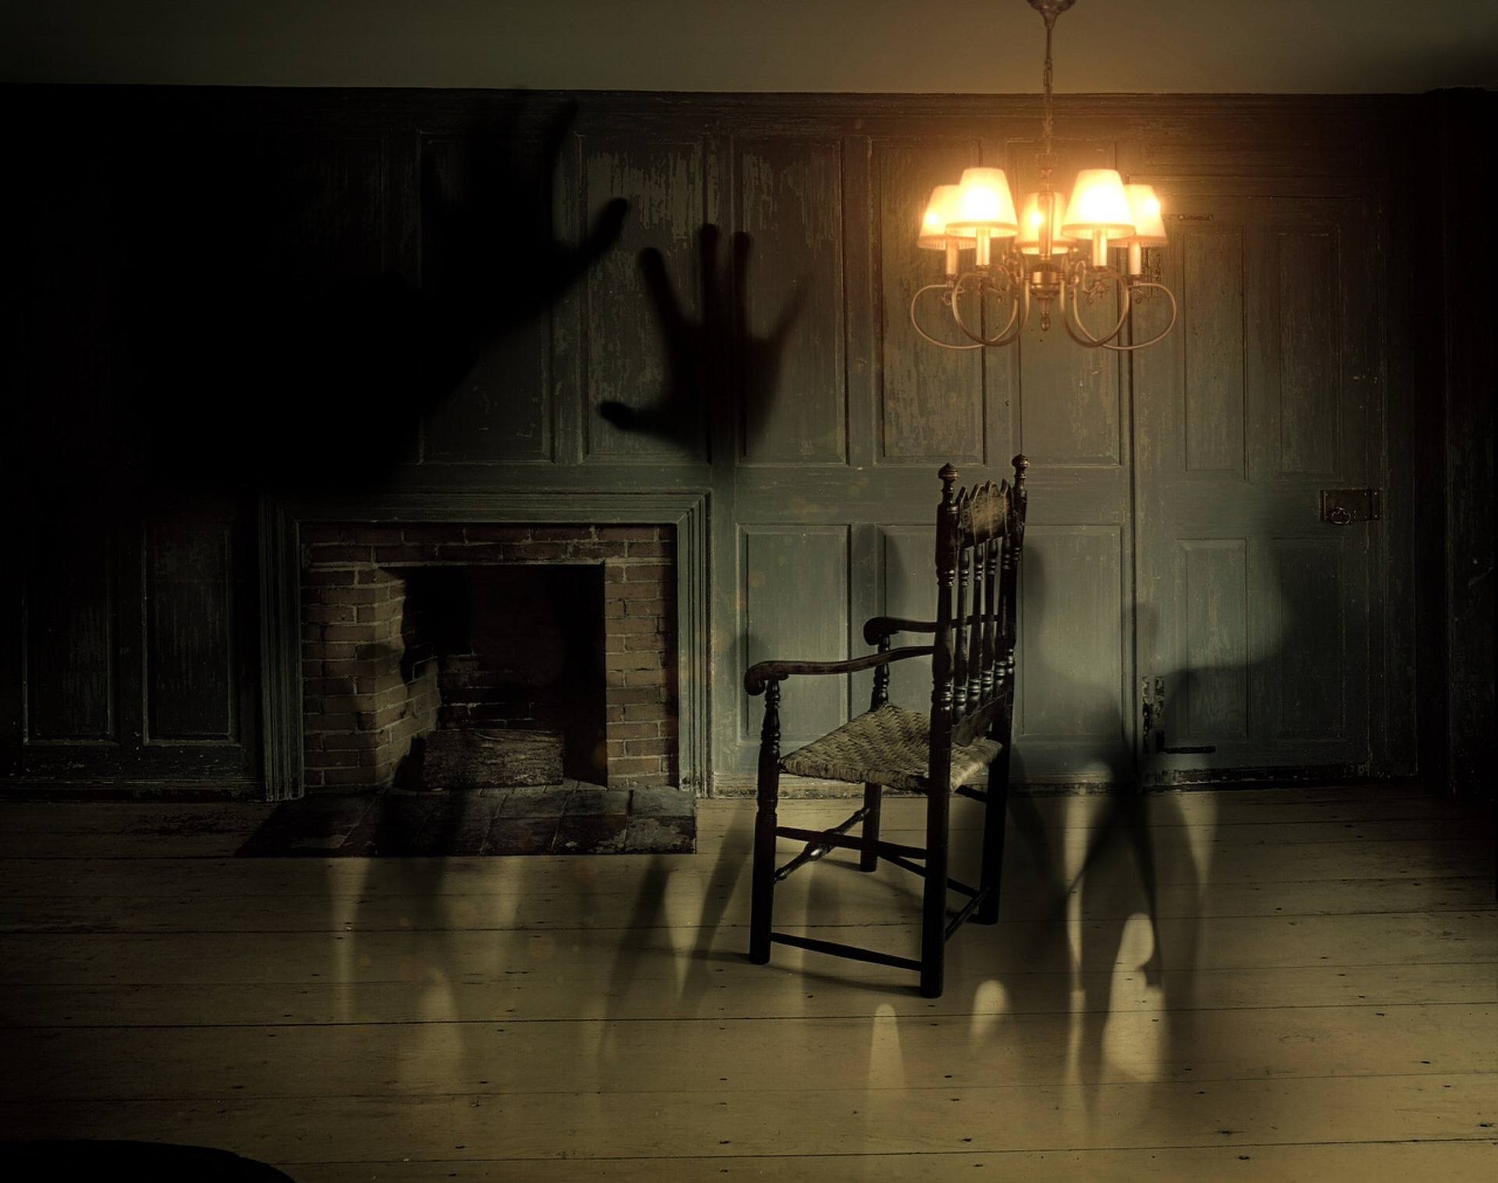
Explore The House

Slide 3

Gather Items and Omens

Slide 4

A Traitor is Among You

Slide 5

Work As A team

Slide 6

Celebrate Your Victory

Slide 7
Lets Play

Slide 8
Posthaunt Demo
VID GOES HERE

Slide 9


Difficulties

Slide 10

The Future

